Slide 1

Multi-Robot Collaboration for Co-Assembly Tasks
By: Rishi Patel
Faculty Advisor: Prof. Weitian Wang
Notes:
Hello Everyone And thank you for being here today.
I’m Rishi Patel and I’m here today to present to you “Multi-Robot Collaboration for Co-Assembly tasks” in simulated environment.
First, Let me tell you that my journey with Robotics began in last Spring semester with Robotics course.
I was really fascinated by the hands-on projects we did during that semester.
So, I started my research to see what does the robotics market looks like.

Slide 2
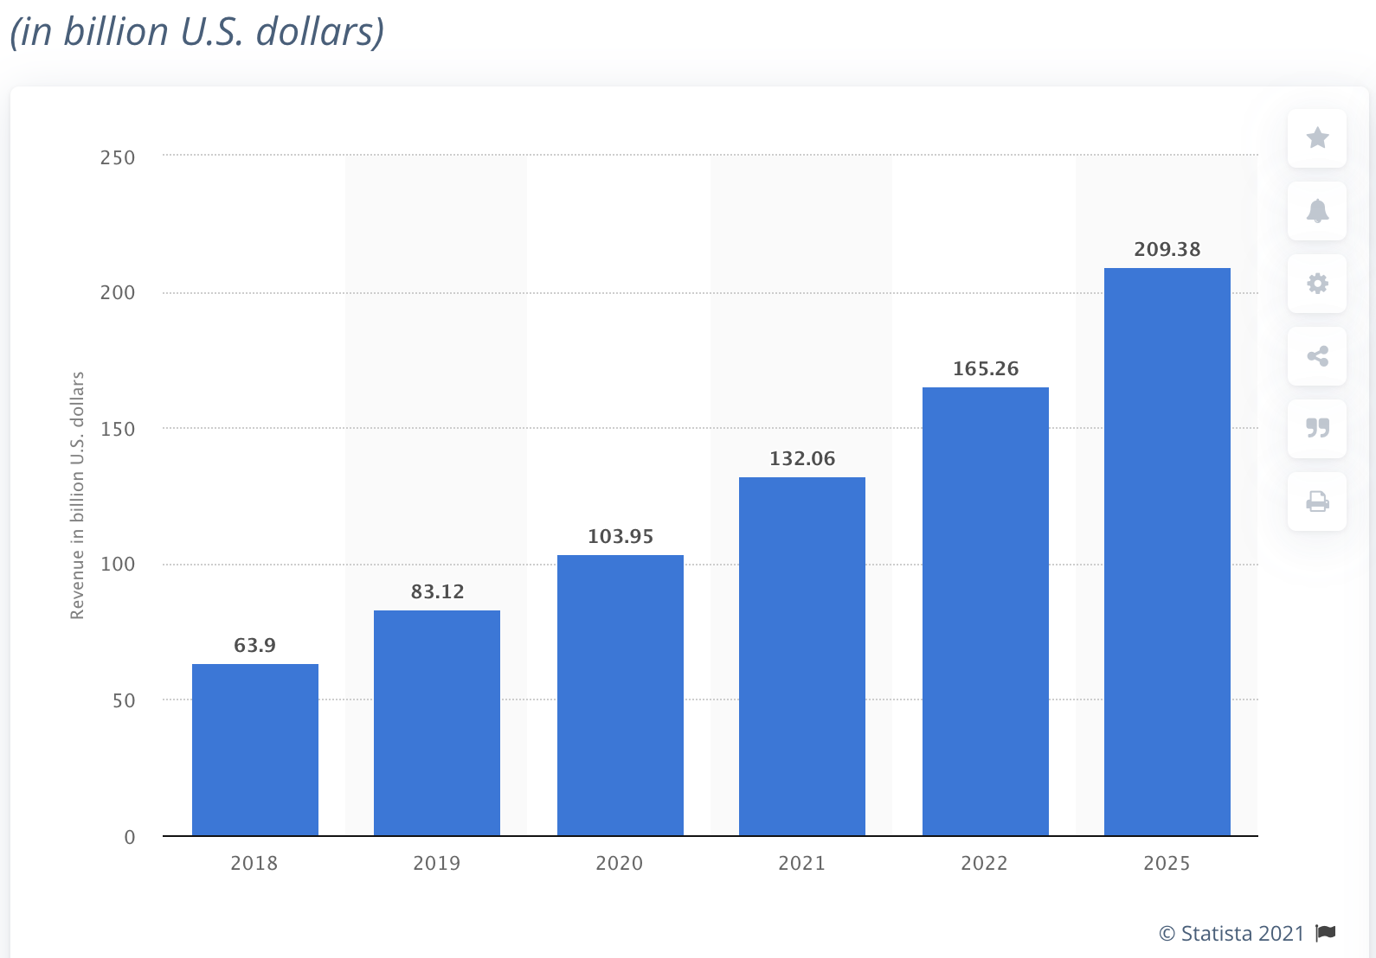
Introduction
Notes:
And I saw that the numbers of robots being used all over the world are increasing exponentially.
And if you see on the slide, This is the exact picture I found a year ago during my research.
Which shows the forecast of the Robotics market in the world for upcoming years.
We all know Robots are being used in many different industries Today.
Like Medical, Military, Manufacturing, Commercial, Agriculture and Food preparation to name few of ‘em.
Although our focus for this project is Arm-robots. So, let’s jump on it right away.

Slide 3
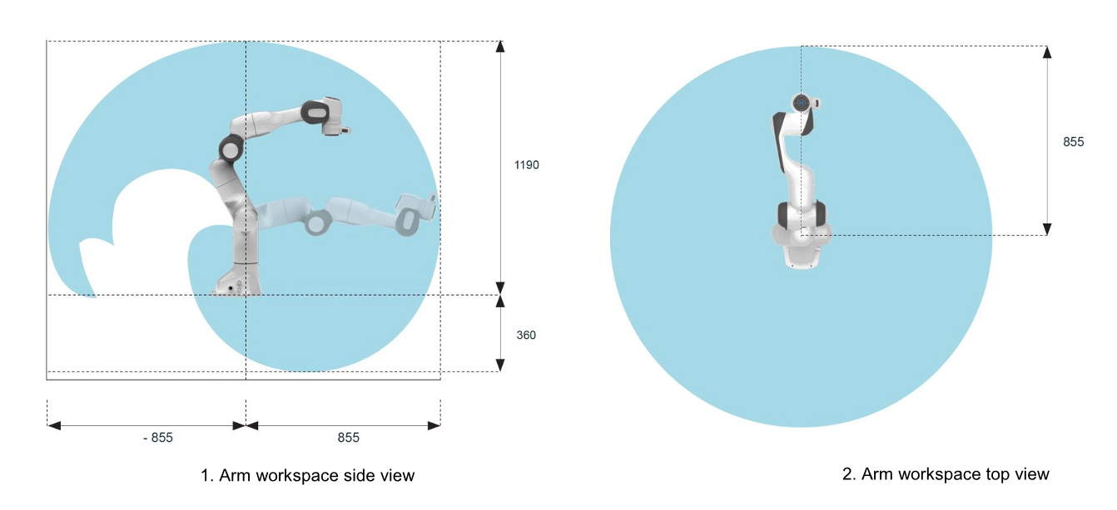
Introduction Cont.
Controlling Multiple arm robots working in the shared workspace.
Notes:
When there are any assembly tasks that you want to get done.
Usually, we feel like it would have been better If we had an extra pair of hands.
Similarly in robotics industry when there are any complex assembly tasks that needs to be done. We prefer to work with more than one robot-arm in the shared workspace.
The slide shows the workspace of a Robot-arm named Panda, which we have used for this project.
Sky-blue area shows where the arm can reach using its end-effector.
In the Image on left – You can see the side view of the workspace
And on the right – You can see the plan / top view of the workspace.
Please NoTE: The front-side of the robot-arm is entirely sky-blue.

Slide 4
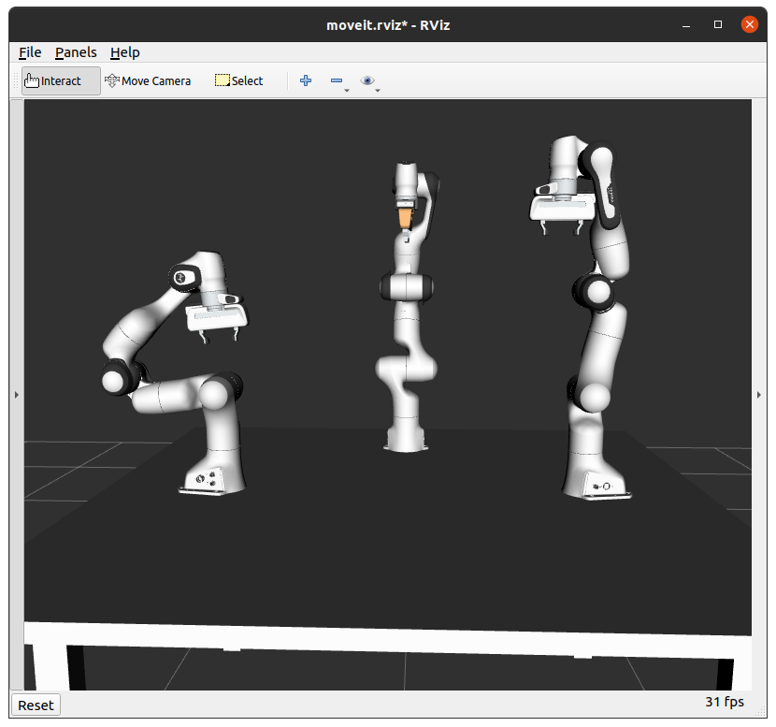
Introduction Cont.
"Task Scheduling" has been identified as a common limitation in previous multi-robot collaboration studies.
Simulated environment to conduct experiments.
Multiple arm manipulation using Python scripts.
Notes:
We did our research and found out that in the prior studies of multi-robot collaboration environment, Lack of proper Task scheduling algorithm is identified as a common issue.
To address that issue, we’ll show how we created the simulated environment of multiple robot-arms in collaboration and then we’ll show the implementation of a generic algorithm used to schedule prioritized tasks in an orderly manner.
As we saw on the earlier slide that the front-side was entirely reachable by the robot-arm through its end-effector, for that reason we have made robot-arms face the center of the table, as you all can see in the picture.

Slide 5
Software
ROS – Robot Operating System
MoveIt
Rviz
Notes:
So here we have listed all the components we used to get the setup ready to do our experiments.
ROS
MoveIt
Rviz

Slide 6
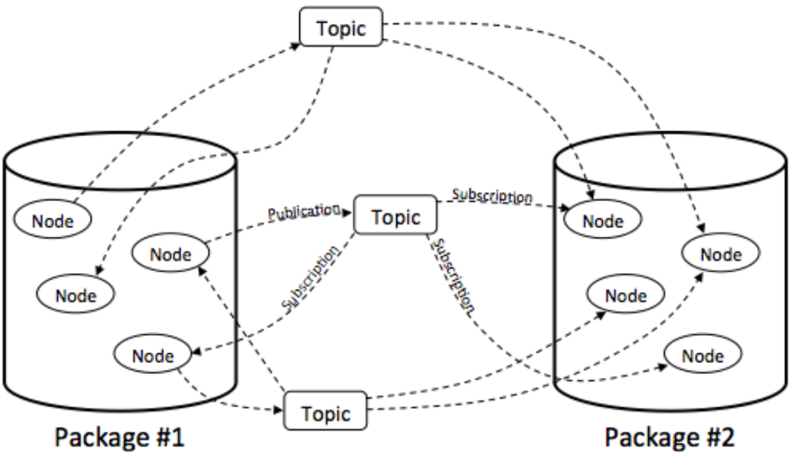
ROS – Robot Operating System
ROS is a middleware that consists of more than 2000 packages
Notes:
The first thing we installed was ROS, which is known as Robot Operating System.
Although ROS is not an Operating System as the name suggests but it’s a middleware which provides a structured communication layer above the host operating system, which is, in our case Ubuntu(20.04)
ROS is divided into more than 2000 packages. And Each package provides different functionality related to robotics.
ROS Nodes are responsible for all the Computations in the ROS.
And using message publish and subscribe method ROS Nodes can publish or subscribe to the ROS topics.
For example: If we make a Python/C++ script to do any computation for ROS, That script is known as a ROS Node.
Please Note: The user must have basic knowledge of coding in Python/C++ and should know what type of ROS message is used by the ROS topic they would want to either publish or subscribe.

Slide 7
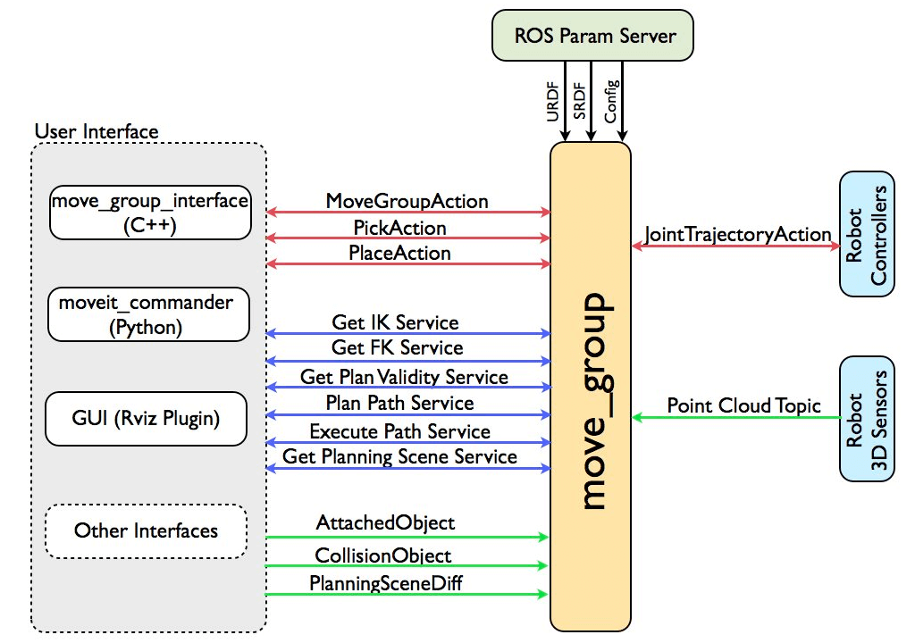
MoveIt
Notes:
The second component what we required after ROS, was MoveIt.
MoveIt is a primary source of the functionality for manipulation in ROS.
“move_group” node is the main node of MoveIt.
There are three ways in which we can access the actions and services provided by the “move_group” node.
Using “move_group_interface” package when coding in C++ :
Using “moveit_commander” package when coding in Python:
And Using “Motion planning plugin” to Rviz through GUI, As it can be seen in the picture.
For this project we used the 2nd option and created Python scripts to move simulated robot-arms.

Slide 8
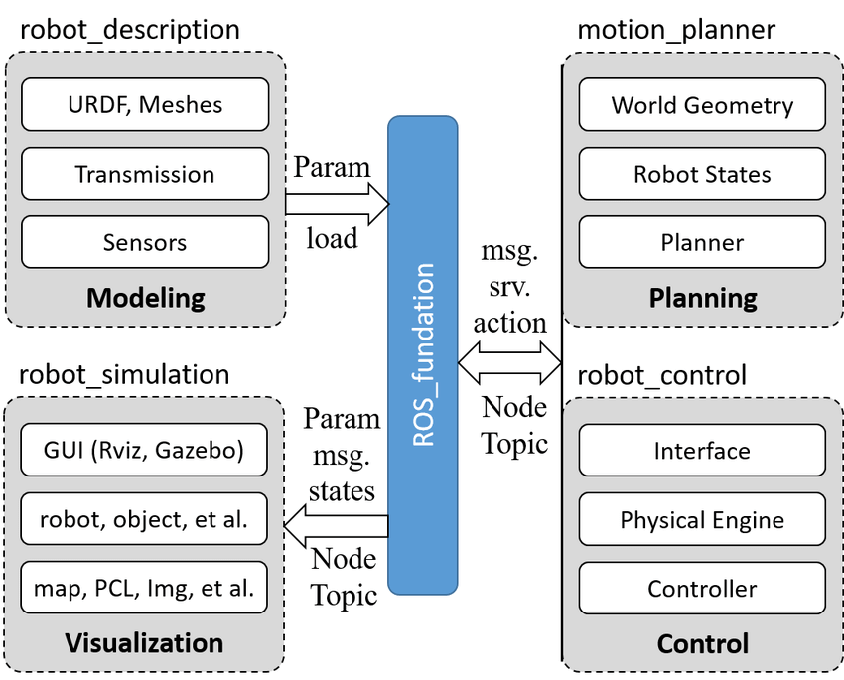
Rviz – ROS Visualization tool
Notes:
The third and most fun component is Rviz, also known as the ROS visualization tool.
Rviz is a graphical interface for ROS that allows you to visualize a large amount of data using plugins for a variety of topics.
Rviz makes it easier for us to view and understand what the robot is seeing and doing in real-time.
It also provides Motion planning Plugin of MoveIt to plan and execute motions on the simulated as well as real robots.
A general robotics simulation architecture can be roughly classified into four key functional modules as shown in the picture.
These are Modeling, Planning, Visualization, and Control

Slide 9
Preparing Setup
URDFs
MoveIt Setup Assistant
Demo.launch
Notes:
We briefed about all the components we need to get the setup ready.
Now here we have listed the tasks we need to complete in order to get the simulation running.
Creating URDFs
Configuring ROS package using MoveIt_Setup_Assistant
Launching Demo.launch file

Slide 10

URDFs
URDF is known as Unified Robotics Description Format.
Notes:
The first task is to create a “URDF” file.
URDF is also known as “Unified Robotics Description Format”.
Which is an XML file describing three-dimensional geometric representation of a robot, its kinematics and geometric visualization meshes as well as other properties relevant to robotics such as courser-grained collision geometry, joint limits, sensors, and dynamic properties such as mass, moment of inertia, and velocity limits.
For this project we took an existing URDF file from “franka_description” package and edited it to make the base look like a table and added two more panda arms on top of it to get the setup of “Three panda arms on top of a table”.
Please NoTe: Once you’re done editing the URDF files, you’ll need to store those URDFs in a ROS package inside a “robots” directory.
In my case I’ve saved all the URDFs inside a ROS package named “3_panda_arm_moveit_config”.

Slide 11
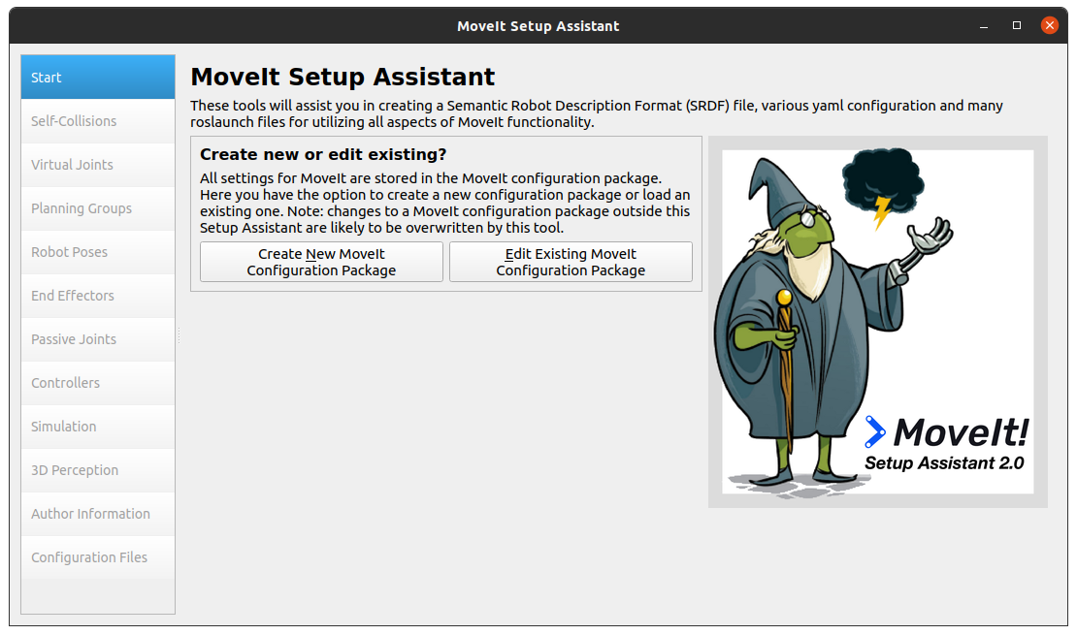
MoveIt Setup Assistant
Launch it by entering following command into the terminal:
roslaunch moveit_setup_assistant setup_assistant.launch
Now load the URDF you saved earlier in it after choosing option to “Create New MoveIt Configuration Package”.
To Build and Source enter following command after navigating to the ROS workspace in your terminal:
catkin build / catkin_make
source devel/setup.bash
Notes:
“MoveIt_Setup_Assistant” is one of many features provided by MoveIt.
Once we have successfully edited and saved the URDFs. We can launch the MoveIt_Setup_Assistant using the command shown in the slide.
Then loading the URDF we just saved, we can configure the package according to our project’s need.
To configure we’ll need to select arm groups, hand groups, end-effectors, controllers, desired poses etc.. as we can see in the pane selector, on the left, inside the image.
At the end it’ll ask us to save the configurations as a ROS package in “Configuration files” pane.
In my case I’ve saved these configurations inside a ROS package named “triple_panda_moveit_config”.
Please NoTe: We’ll need to build and source the ROS workspace, every time we create a new ROS package.
These commands are shown in the slide.

Slide 12
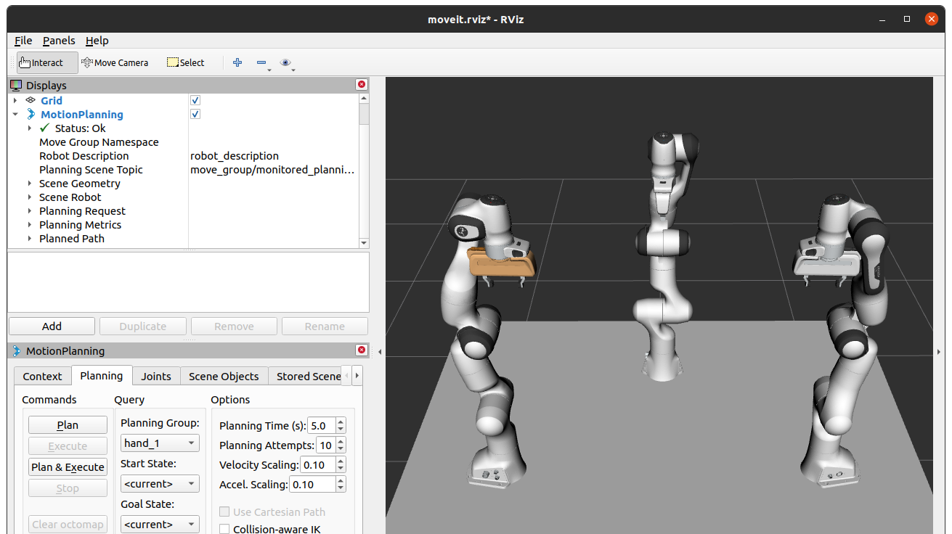
Demo.launch
“Demo.launch” can be launched in Rviz by entering a command in the terminal in following manner:
roslaunch <package_name> demo.launch
In our case the command looks like this:
roslaunch triple_panda_moveit_config demo.launch
Notes:
Do you remember the configuration package that we saved at the end of the “MoveIt_setup_Assistant”?
We also saved a “demo.launch” file in that package and we’ll need to launch that file to get the set-up running.
To launch it we’ll have to enter the command inside a terminal.
The command looks like ^^roslaunch package_name demo.launch
After few seconds you should see the screen as it is show in the background of this slide which we’ll use to conduct our experiments.
Please NoTe: we’ll need to create a scripts directory inside our ROS package to store all the Python scripts.

Slide 13
ROS Packages
3_panda_arm_moveit_config : URDFs + XACROs + Meshes
triple_panda_moveit_config: Saved configurations + Codes
Notes:
Now, we have the setup ready to experiment and our setup is basically summarized in two ROS packages.
1st is 3_panda_arm_moveit_config package,
which consists of all the URDF and XACRO files. And
2nd is Triple_panda_moveit_config package,
which is our main ROS package with all saved configurations, and it also consists the Python scripts we used to conduct all the experiments.

Slide 14
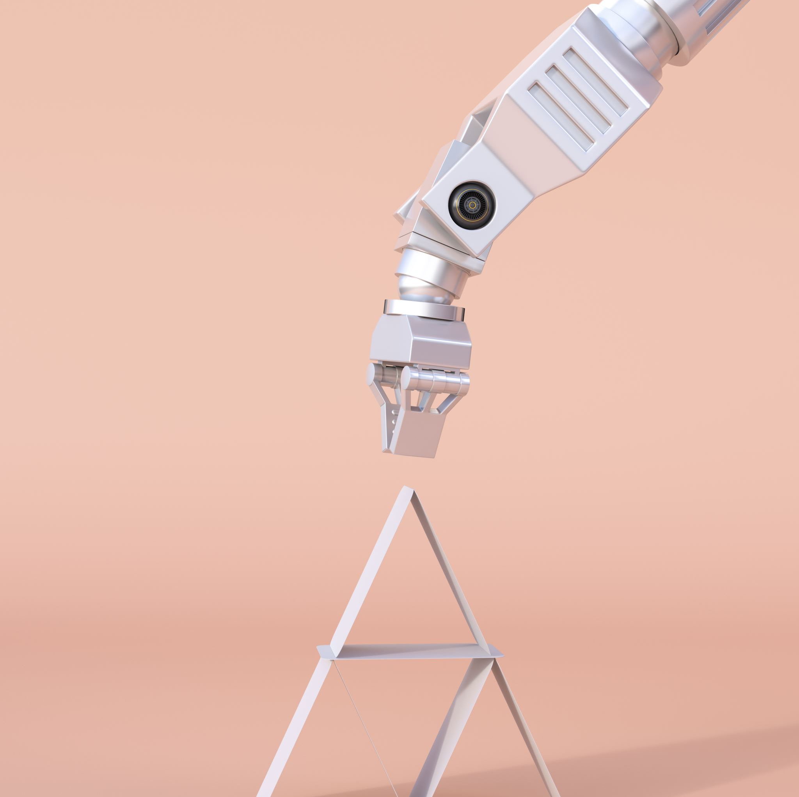
Experiment
Basic robot Arm Motion using Poses for the end-effector
Using Poses
Using Cartesian motion
Notes:
Now since we have the setup ready to conduct the experiments, Here we have listed a couple of experiments we conducted to finalize the method of manipulating arm-robots.
For the 1st experiment we used arm poses to manipulate a robot arm. and
For the 2nd experiment we used cartesian motion to manipulate a robot arm

Slide 15
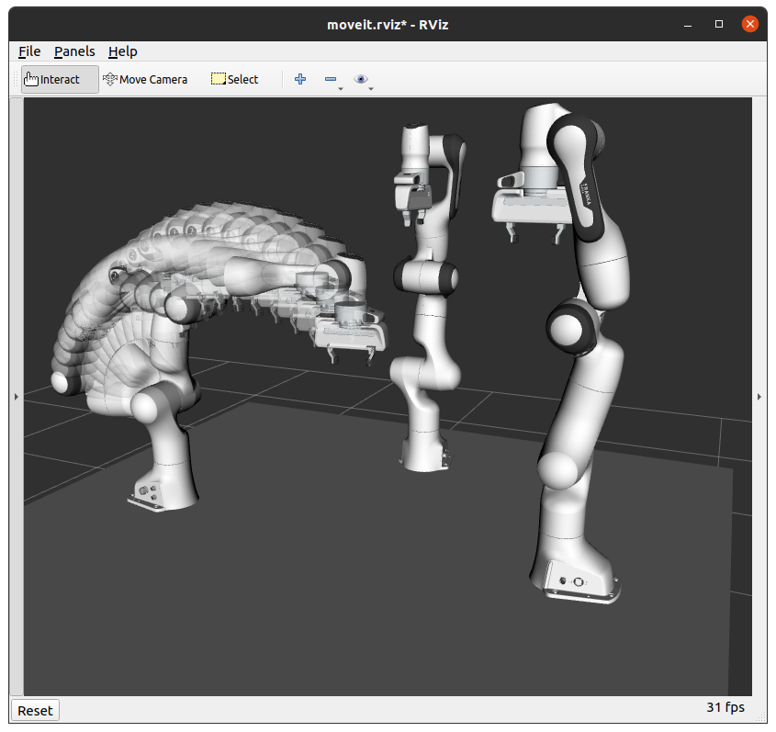
1. Using Poses
Notes:
A Step-by-step trail of a simple motion (from point A to point B) is shown in the picture to give you a rough idea how the arm_1 moved using poses.

Slide 16
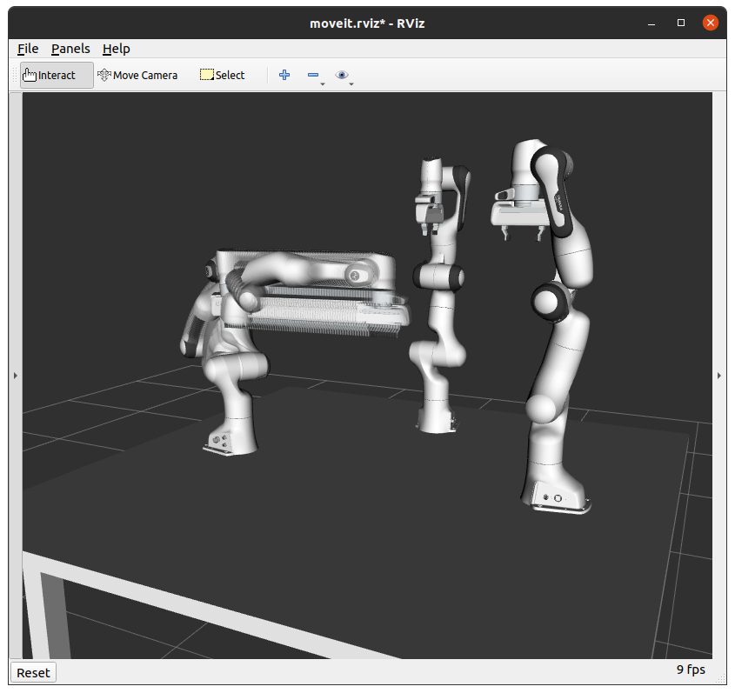
2. Using Cartesian Motion
Notes:
A Step-by-step trail of a cartesian motion (from point A to point B) is shown in the picture to give you a rough idea how the arm_1 moved.
We decided to use Cartesian motions to manipulate arm-robots, to minimize or eliminate trivial movements by the robot-arms.

Slide 17
Task Scheduling using “Merge-Sort”
Set up
The Merge-Sort
Implementation
Notes:
Since we’ve finalized the method of manipulating robot-arms, now is the time for us to show the generic algorithm we’re talking about, the “Merge-Sort” algorithm.
Here we have listed the steps we’ll go through to show how its used in this project to schedule prioritized tasks.
Setup
The Merge-Sort
Implementation

Slide 18
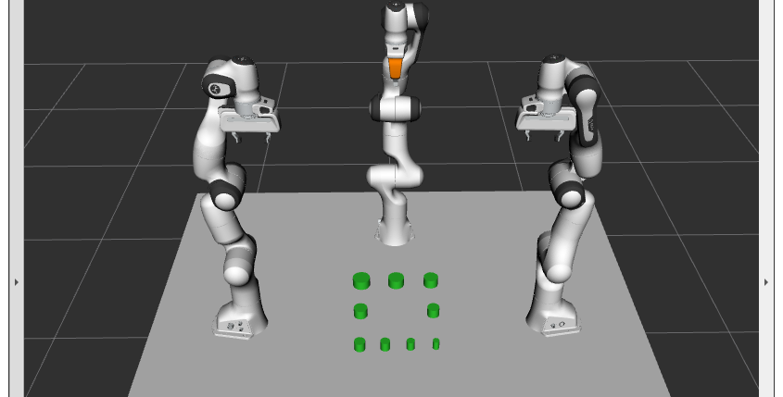
Set up
Notes:
The set up for this experiment required us to have a prioritized assembly task in the shared workspace, So we went ahead and generated nine (9) solid rings (each of different size).
So, let’s first understand the setup before we look at the requirements.
The robot arm on the left is “panda_arm_1”
The arm on the right is “panda_arm_2”
And the middle arm is “panda_arm_3”
And the objects are named ring_1 to ring_9.
Now, Let’s understand the requirements of this experiment….
To stack these nine (9) rings, in a way that the largest one goes in the bottom and smallest one goes on the top, So we kind of have a round pyramid looking tower.
Other condition was that each robot-arm must set 3 objects, not more/less than three, and these assignment of object should be random.
Implementing the “Merge-Sort” sorting algorithm to sort these sub-tasks to achieve 1’st objective.
Next, we’ll see the Merge-Sort Algorithm

Slide 19
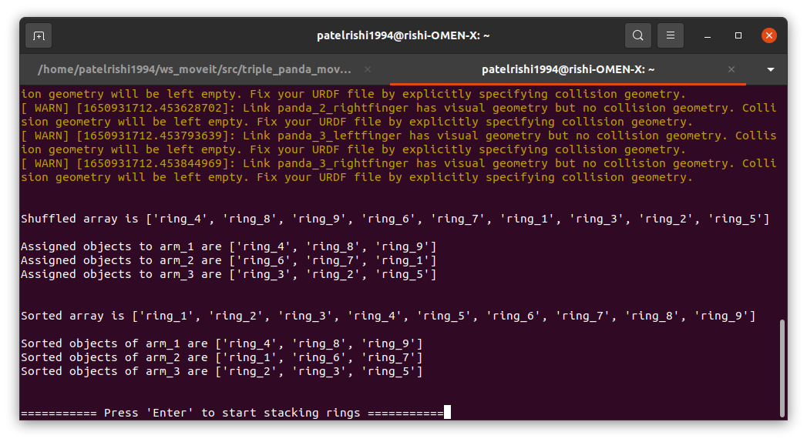
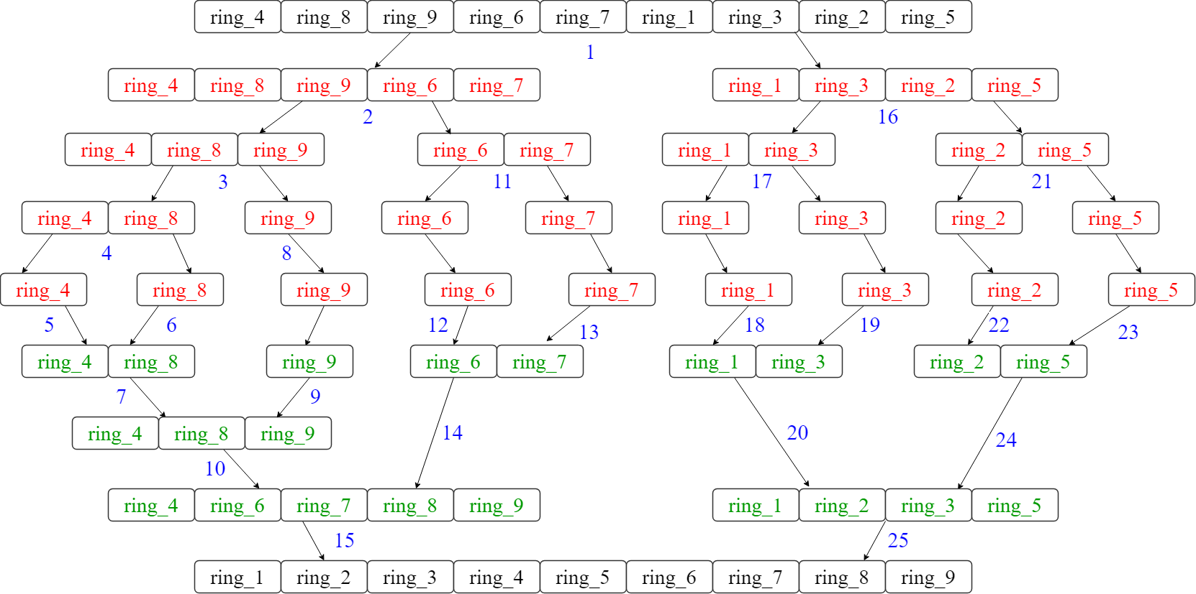
The Merge-Sort
The Merge Sort algorithm has the best, average and worst-case time complexity of n*log(n).
Notes:
The Merge-Sort algorithm works on divide and conquer principle.
Which basically divides the problem into smaller sub-problems by calling itself recursively and then combine the solved sub-problems to form a complete solution.
We implemented the Merge-Sort algorithm in top-down manner to break the list into pieces and than combine the sorted pieces to form a sorted-list.
We used the merge-sort algorithm to sort four lists in total,
one is the list of objects and other three are list of assigned objects to each arm. (As we can see in the picture on the left).
Image on the right show the implementation of the Merge-Sort algorithm on the shuffled list of objects.
Red Color: represents that the list is being split into smaller pieces. By calling the algorithm recursively.
Green Color: represents the Merging of the sorted elements of the list.
Blue Colored numbers indicate the order in which the steps are processed.

Slide 20
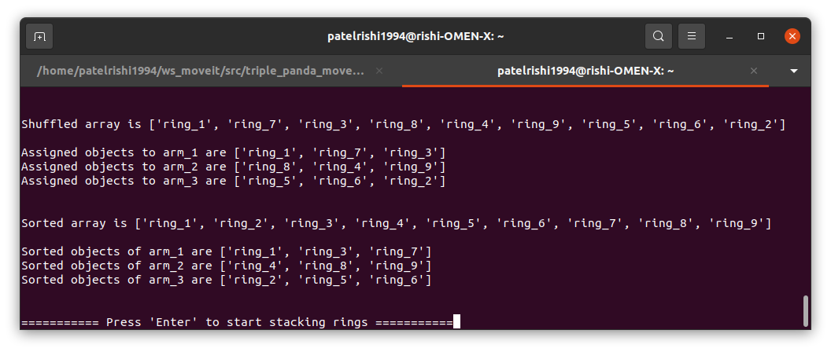
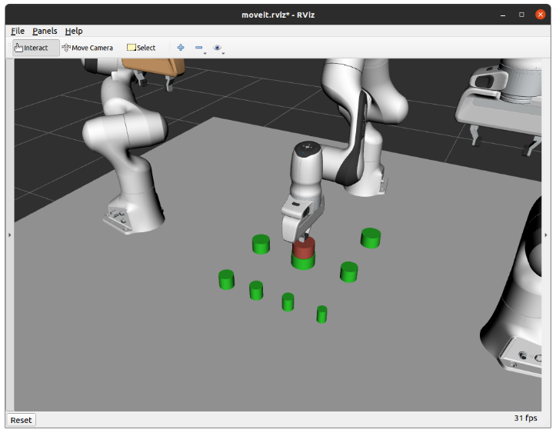
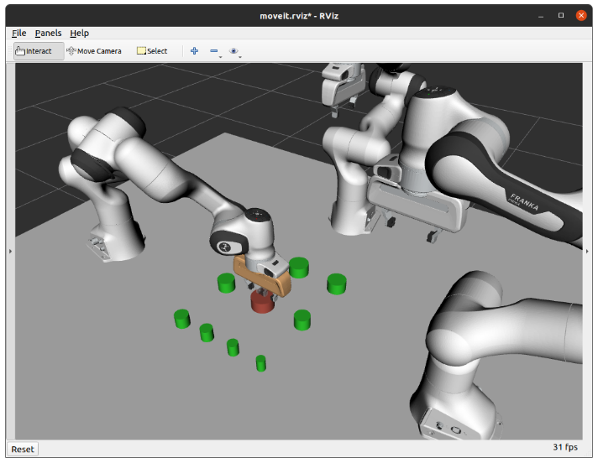
Implementation
Notes:
As we saw earlier that each arm is assigned objects randomly every time. The image on the top shows the assigned objects to each arm.
You don’t need to memorize this terminal screenshot. It’s been attached in each following slides to keep track.
Panda_arm_1 ➔ ring_1
Panda_arm_3 ➔ ring_2

Slide 21
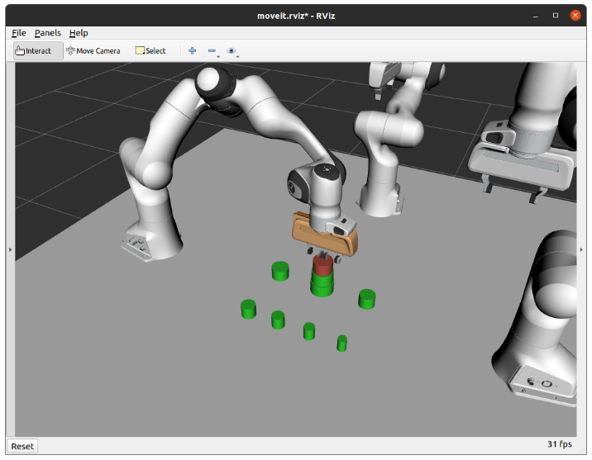
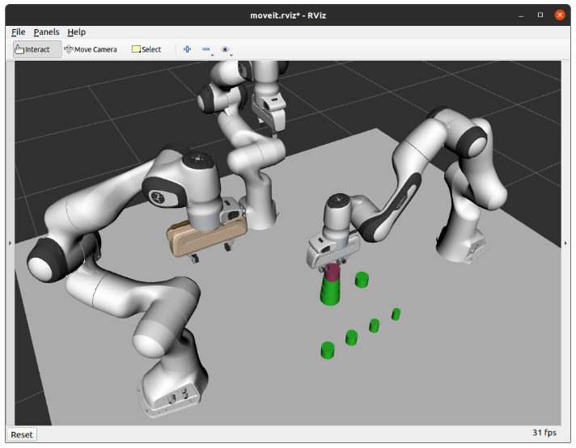
Implementation Cont.
Notes:
Panda_arm_1 ➔ ring_3
Panda_arn_2 ➔ ring_4

Slide 22
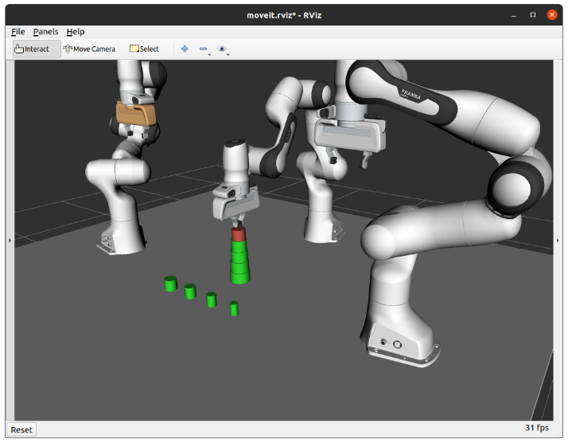
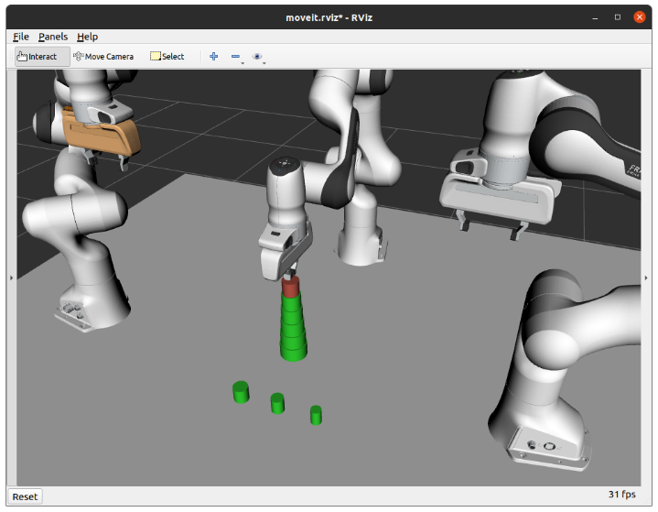
Implementation Cont.
Notes:
Panda_Arm_3 ➔ Ring_5 and ring_6

Slide 23
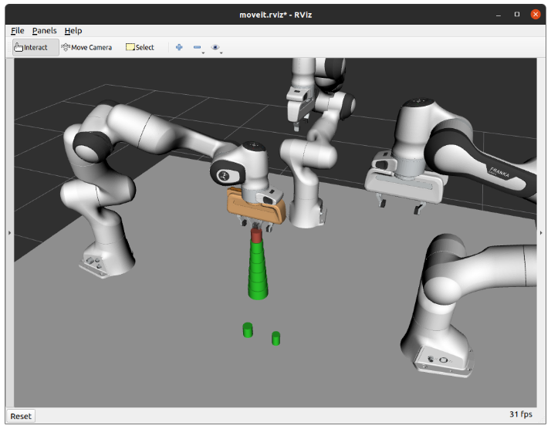
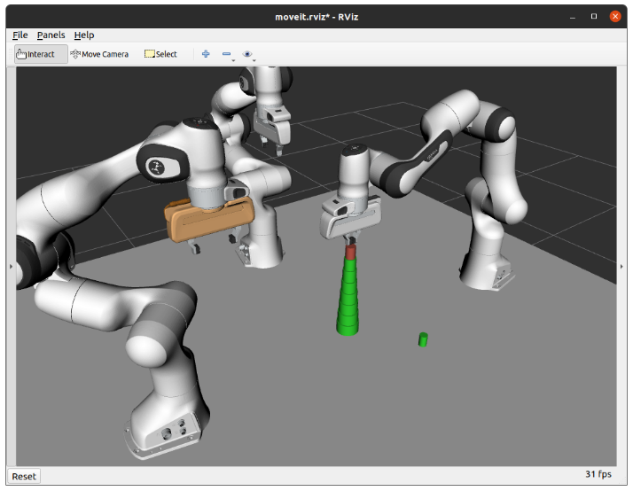
Implementation Cont.
Notes:
Panda_arm_1 ➔ Ring_7 and
Panda_arm_2 ➔ ring_8

Slide 24
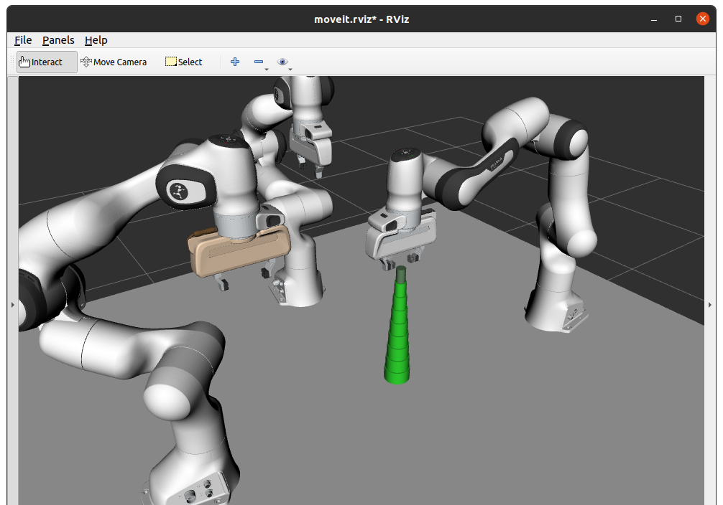
Implementation Cont.
Notes:
Panda_arm_2 ➔ ring_9

Slide 25
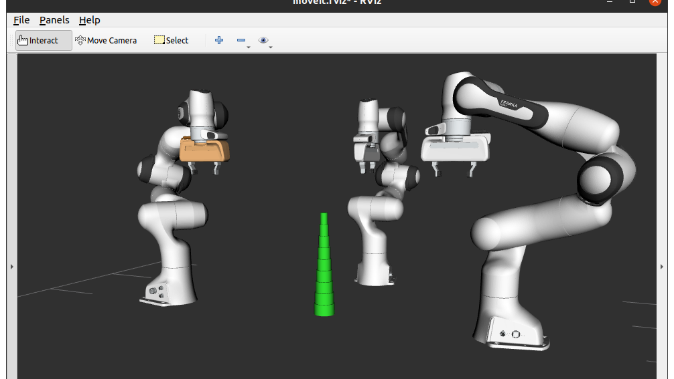
Result & Analysis
Result shows the assembly task has been finished successfully by multiple arm robots in the shared workspace.
A generic algorithm like the Merge-Sort can be used to effectively schedule tasks and the sub-tasks.
Notes:
The result demonstrates that the assembly operation that was being performed in the shared workplace by three robot arms have been completed successfully.
To schedule tasks and subtasks in an efficient manner, one can make use of a general-purpose algorithm such as the “Merge-Sort”.

Slide 26
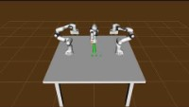
Notes:
Now, Let’s see a video demonstration of three panda arms working in collaboration to complete the assembly-task.

Slide 27
Future Works
The future works for this project should include “Dynamic collision checking” for real-time collision detection.
This assembly work can be done in significantly less amount of time if the waiting time is reduced or eliminated by implementing “Dynamic collision checking”, which allows the robot arms to check for collision objects in their planned path and be able avoid it, even after the arm has started moving.
Other future work implementation should make these arms mobile, by putting them on wheels.
To work with different groups of arm robots in a vicinity to finish co-assembly tasks employing RPCs.

Slide 28

Thank You
Notes:
Finally, I'd like to thank everyone for sticking with me through my presentation, and I'd especially like to thank Dr. Weitian Wang for guiding me through this wonderful journey of learning robotics. I would make the most of it and keep learning more about it in the coming years.

